Slide 1
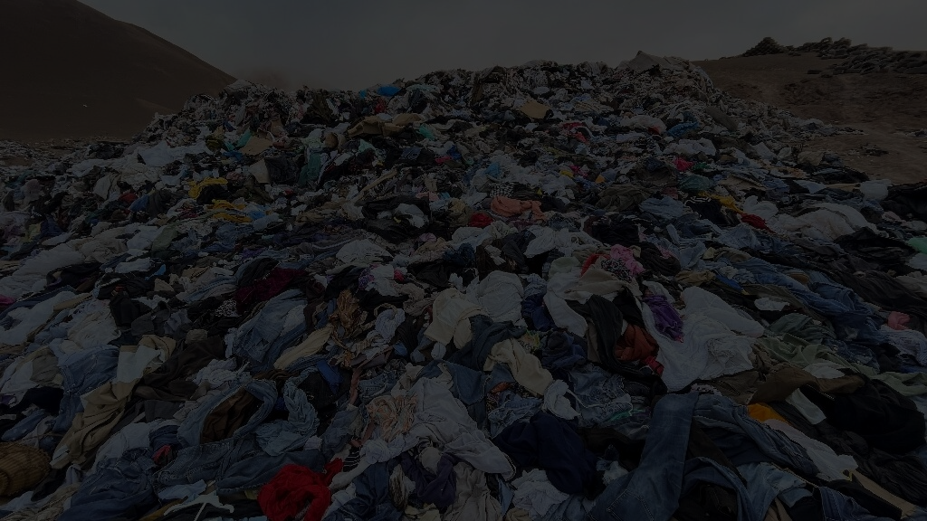

Slide 2
Each Year…

Slide 3
Each Year…
92 Million tonnes of wasted textile

Slide 4
Each Year…
92 Million tonnes of wasted textile
17 Million tonnes from North America

Slide 5
Each Year…
92 Million tonnes of wasted textile
17 Million tonnes from North America
Average North American Consumer: 81 lbs

Slide 6
By the Year 2030…

Slide 7
By the Year 2030…
Projected to increase to 134 million tonnes of textile waste

Slide 8







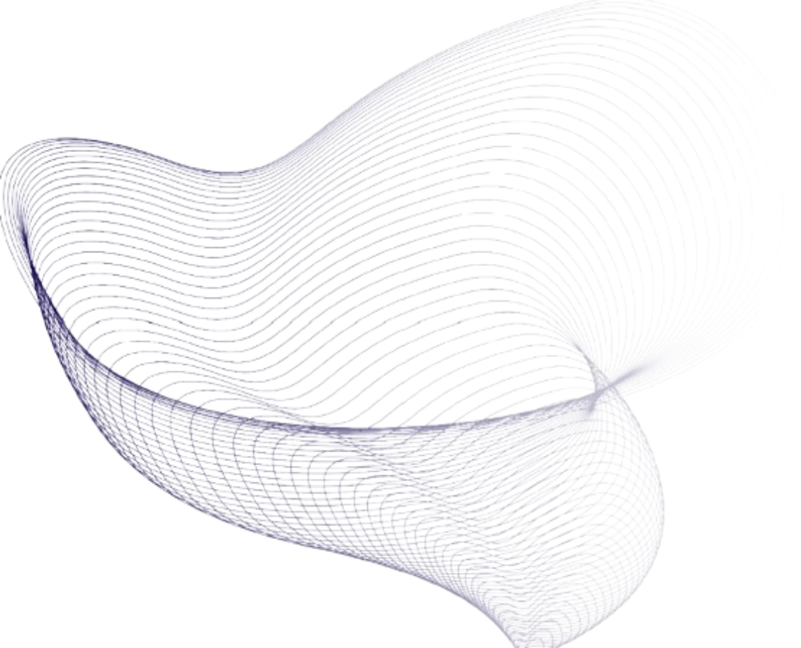
Emergrade
Alexia

Slide 9

Executive Summary
Alexia
Problem
How might we create a solution to reduce the amount of clothing that ends up in landfills
Criteria
Sustainable
Ethical
Scalable
Recommendation
Emergrade by Alexia
Impacts
Reduce textiles in landfills
Prevent purchases by data analysis
Can be used by users all around the world
Analysis Solution Implementation Impacts Risks

Slide 10
Key Issues
Alexia
HIGH RETURN RATES
LACK OF CUSTOMER AWARENESS
VIRTUALIZING SHOPPING EXPERIENCE THROUGH VTON
LEVERAGING AI ON BRAIN WAVE FREQUENCY
DATA STRATEGY AND IMPACT MEASUREMENT

Slide 11
Key Issues
Alexia
HIGH RETURN RATES
LACK OF CUSTOMER AWARENESS
VIRTUALIZING SHOPPING EXPERIENCE THROUGH VTON
LEVERAGING AI ON BRAIN WAVE FREQUENCY
DATA STRATEGY & IMPACT MEASUREMENT

Slide 12
Gap Analysis
Alexia
Current State
Desired State
Unsustainable Consumption Model
High Return Rates
Impulse Driven Waste
Landfill Crisis
Lack of Consumer Data
Analysis Solution Implementation Impacts Risks

Slide 13
Gap Analysis
Alexia
Current State
Desired State
Unsustainable Consumption Model
High Return Rates
Impulse Driven Waste
Landfill Crisis
Lack of Consumer Data
Sustainable Shopping Experience
Generative-AI driven Confidence
Data-Driven Mindfulness
Reduced Return Rates
Reduced Waste in Landfill
Analysis Solution Implementation Impacts Risks

Slide 14
Gap Analysis
Alexia
Current State
Desired State
Unsustainable Consumption Model
High Return Rates
Impulse Driven Waste
Landfill Crisis
Lack of Consumer Data
Key Enabler
Sustainable Shopping Experience
Generative-AI driven Confidence
Data-Driven Mindfulness
Reduced Return Rates
Reduced Waste in Landfill
Two Prong Web Application
Consumer Focused
Analysis Solution Implementation Impacts Risks

Slide 15
Gap Analysis
Alexia
Current State
Desired State
Unsustainable Consumption Model
High Return Rates
Impulse Driven Waste
Landfill Crisis
Lack of Consumer Data
Key Enabler
Sustainable Shopping Experience
Generative-AI driven Confidence
Data-Driven Mindfulness
Reduced Return Rates
Reduced Waste to Landfill
Key Takeaway:
Leveraging Generative AI and using Data-Driven Solutions to reduce landfill waste through consumers
Two Prong Web Application
Consumer Focused
Analysis Solution Implementation Impacts Risks

Slide 16


Persona Analysis
Alexia
Pain Points
Pain Points
“Bracketing” For Fit
Emotional Impulse Buying
Sustainability Guilt
Jasmine
Young Canadian Consumer
Needs
Needs
James
Middle-Aged
American
Consumer
Analysis Solution Implementation Impacts Risks

Slide 17
Persona Analysis
Alexia
Pain Points
Pain Points
“Bracketing” For Fit
Emotional Impulse Buying
Sustainability Guilt
Jasmine
Young Canadian Consumer
Needs
Needs
James
Middle-Aged
American
Consumer
Visual Confidence Tool
Mindfulness Reminder
Sustainability Assurance
Analysis Solution Implementation Impacts Risks

Slide 18
Persona Analysis
Alexia
Pain Points
Pain Points
“Bracketing” For Fit
Emotional Impulse Buying
Sustainability Guilt
Inconvenience of Return Process
Size Uncertainty
Unintentional Impulse Purchases
Jasmine
Young Canadian Consumer
Needs
Needs
James
Middle-Aged
American
Consumer
Visual Confidence Tool
Mindfulness Reminder
Sustainability Assurance
Analysis Solution Implementation Impacts Risks

Slide 19
Persona Analysis
Alexia
Pain Points
Pain Points
“Bracketing” For Fit
Emotional Impulse Buying
Sustainability Guilt
Inconvenience of Return Process
Size Uncertainty
Unintentional Impulse Purchases
Jasmine
Young Canadian Consumer
Needs
Needs
James
Middle-Aged
American
Consumer
Visual Confidence Tool
Mindfulness Reminder
Sustainability Assurance
Efficient Decision Process
Guaranteed Fit
Value Validation
Analysis Solution Implementation Impacts Risks

Slide 20

Persona Analysis
Alexia
Pain Points
Pain Points
“Bracketing” For Fit
Emotional Impulse Buying
Sustainability Guilt
Inconvenience of Return Process
Size Uncertainty
Unintentional Impulse Purchases
Key takeaway:
Virtualizing the shopping experience from start to finish, streamlining the decision process and making online clothing consumption smoother and simpler for all users.
Jasmine
Young Canadian Consumer
Needs
Needs
James
Middle-Aged
American
Consumer
Visual Confidence Tool
Mindfulness Reminder
Sustainability Assurance
Efficient Decision Process
Guaranteed Fit
Value Validation
Analysis Solution Implementation Impacts Risks

Slide 21
Key Criteria
Alexia
Tool
Key Takeaway
Criteria
GAP
Reducing landfill waste through virtualizing shopping experience from start to finish
Sustainable
Preventing regretful purchases through data-driven cognitive intervention
Ethical
Persona
Available and easy to use for users
around the world
Scalable
Analysis Solution Implementation Impacts Risks

Slide 22

Alternatives
Alexia
Comparing Competitors and Emergrade by Alexia to Criterias
 | Sustainability | Ethical | Scalable
Standard VTON Apps
Sustainable Fashion Subscription
Emergrade by Alexia
Analysis Solution Implementation Impacts Risks

Slide 23
Solution:
Emegrade by Alexia
Virtual Change Room
EEG Driven Suggestion System

Slide 24
Prong 1
Virtual Change Room

Slide 25
Virtual Change Room
Alexia
Tool
Case Use
Benefit
Generative AI Model
Digital Garment Overlay
Increase purchase confidence. Reduce returns from poor fit or aesthetics
Analysis Solution Implementation Impacts Risks

Slide 26
Virtual Change Room
Alexia
Tool
Case Use
Benefit
Generative AI Model
Digital Garment Overlay
Increase purchase confidence. Reduce returns from poor fit or aesthetics
Two-Image Input System
Personalized Virtual Try-On
Creates the “change room” experience virtually
Analysis Solution Implementation Impacts Risks

Slide 27
Virtual Change Room
Alexia
Tool
Case Use
Benefit
Generative AI Model
Digital Garment Overlay
Increase purchase confidence. Reduce returns from poor fit or aesthetics
Two-Image Input System
Personalized Virtual Try-On
Creates the “Change room” experience virtually
Virtual Assistant
User Size Uncertainty
Suggests personalized sizing recommendations based on user data
Analysis Solution Implementation Impacts Risks

Slide 28
Prong 2
EEG Driven Suggestion System

Slide 29
EEG Drive Suggestion System
Alexia
User wears a Muse 2
Analysis Solution Implementation Impacts Risks

Slide 30
EEG Drive Suggestion System
Alexia
User wears a Muse 2
1 minute session to track live EEG
Analysis Solution Implementation Impacts Risks

Slide 31
EEG Drive Suggestion System
Alexia
User wears a Muse 2
1 minute session to track live EEG
Obtains EEG data from 1 live tracking
Analysis Solution Implementation Impacts Risks

Slide 32
EEG Drive Suggestion System
Alexia
User wears a Muse 2
1 minute session to track live EEG
Obtains EEG data from 1 live tracking
Based on EEG suggests users if purchase is impulsive or not
Analysis Solution Implementation Impacts Risks

Slide 33
Timeline
Alexia
Short Term
Medium Term
Long Term
Q1
Q2
Q3
Q4
Q1
Q2
Q3
Q4
Y3
Y4
Virtual Change Room
Pilot Group Test
Improve Application
Launch
Track
EEG Drive Suggestion System
Integrate
Prong 2
Test
Market
& outreach
Launch
Track
Analysis Solution Implementation Impacts Risks

Slide 34
Financials
Alexia
Item | Cost
Development & Prototyping | $2,500
Core Infrastructure | $500
Hardware & Testing | $700
Legal & Compliance | $1,500
Contingency | $500
Startup Cost: $ 5,700
Monthly Expense
Analysis Solution Implementation Impacts Risks

Slide 35
KPI
Alexia
Key Performance Indicators
Impulse Interruption Rate
Impulse Interruption Rate
User Satisfaction Rate
25%
10%
90%
Analysis Solution Implementation Impacts Risks

Slide 36

Risks and Mitigation
Alexia
Risk:
Unauthorized User Access
Risk:
1
1
2
1
2
Mitigation:
OTP or Google Verification on Login
Mitigation:
Encryption of all incoming Data
2
Analysis Solution Implementation Impacts Risks

Slide 37
Risks and Mitigation
Alexia
Risk:
Unauthorized User Access
Risk: Storage of Sensitive Data
1
1
2
1
2
Mitigation:
OTP or Google Verification on Login
Mitigation:
Encryption of all incoming Data
2
Analysis Solution Implementation Impacts Risks

Slide 38
Executive Summary
Alexia
Problem
How might we create a solution to reduce the amount of clothing that ends up in landfills
Criteria
Sustainable
Ethical
Scalable
Recommendation
Emergrade by Alexia
Impacts
Reduce textiles in landfills
Prevent purchases by data analysis
Can be used by users all around the world
Analysis Solution Implementation Impacts Risks

Slide 39


Slide 40


Slide 41
Emergrade
Alexia

